Slide 1
the Cda roadmap: transformative cooperatives
By: usec. Orlando r. ravanera

Slide 2
How ?
Image building
Create strong alliances

Slide 3
glaring realities

Slide 4
Growth at all cost versus development paradigm

Slide 5
Gross inequality – on Distribution of Wealth
The eight richest people on the planet are worth more than the combined wealth of half the world’s population
The wealth of the 10 richest Filipinos grew 220% within 2010-2015 while the real value of the average daily basic pay of wage and salary workers rose by just 5.3%

Slide 6
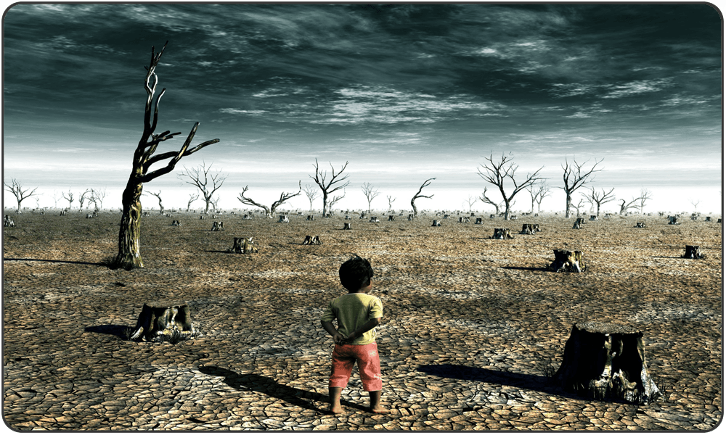
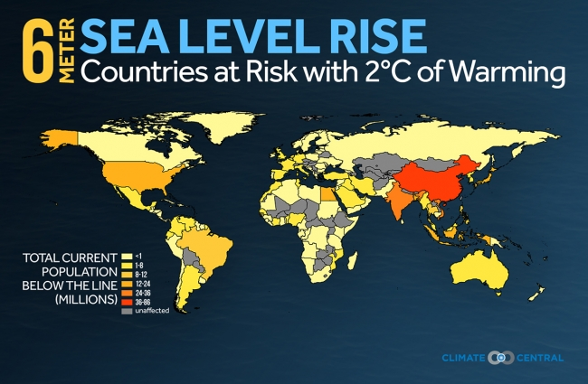
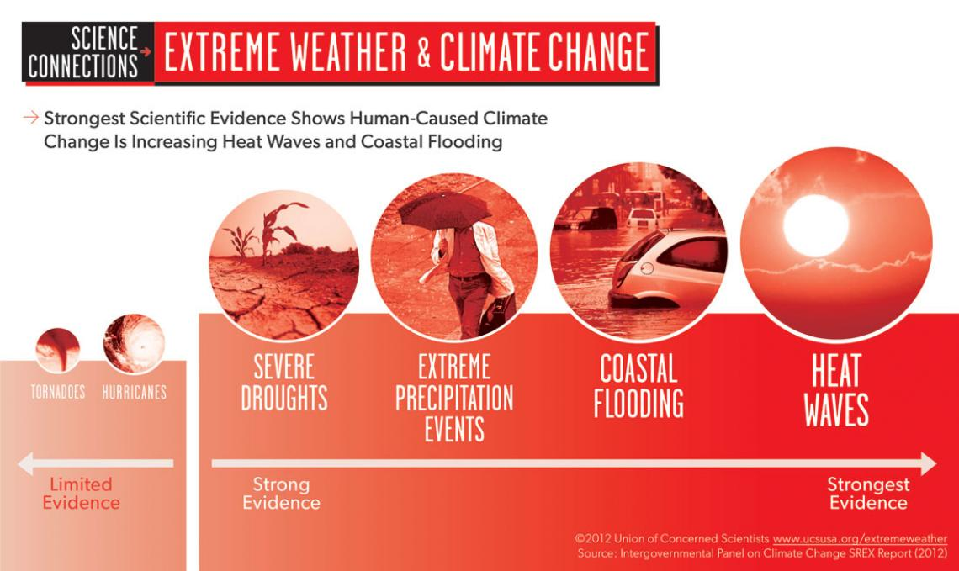
Unsustainability in ecology
Global warming melting of iceberg rising of oceans climate change

Slide 7
Unsustainability in ecology
DEGRADED COAST
BIODIVERSITY HOTSPOT
WATER
CRISIS
DEFORESTATION
70% of reefs at high/very high risk, among world’s “coral hotspots”, 76% of mangroves lost
The islands that make up the Philippines used to be all forested. Today only 35% of those forests remain.
4th country in Asia with most number of
threatened species (221 fauna, 526 flora)
67% of river systems unsafe
58% of groundwater contaminated
25 major rivers biologically dead
17 million hectares of dipterocarp forests were lost in the last 100 years

Slide 8
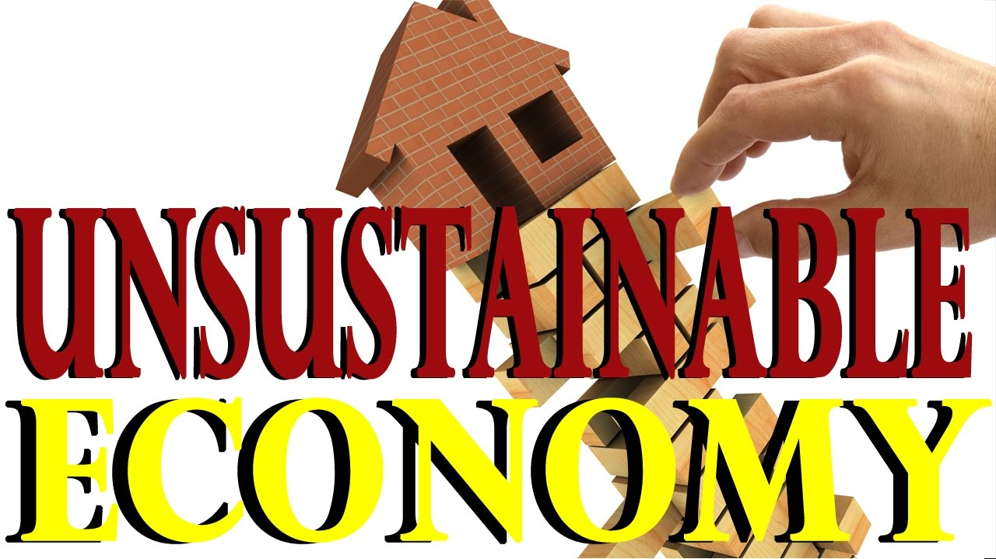

Slide 9
This contemporaneous development paradigm was only successful in sacrificing the people & mother earth to the altar of greed & profit
money must be used to make life better for the people!

Slide 10
Gross inequality – on Land Distribution
9 out of 10 farmers are landless; 75% of all land reform beneficiaries are unable to pay land amortizations (IBON)
Farmers are the one feeding the nation and yet their dining table have no food

Slide 11
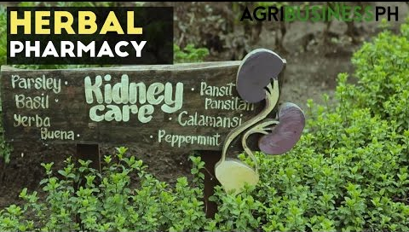
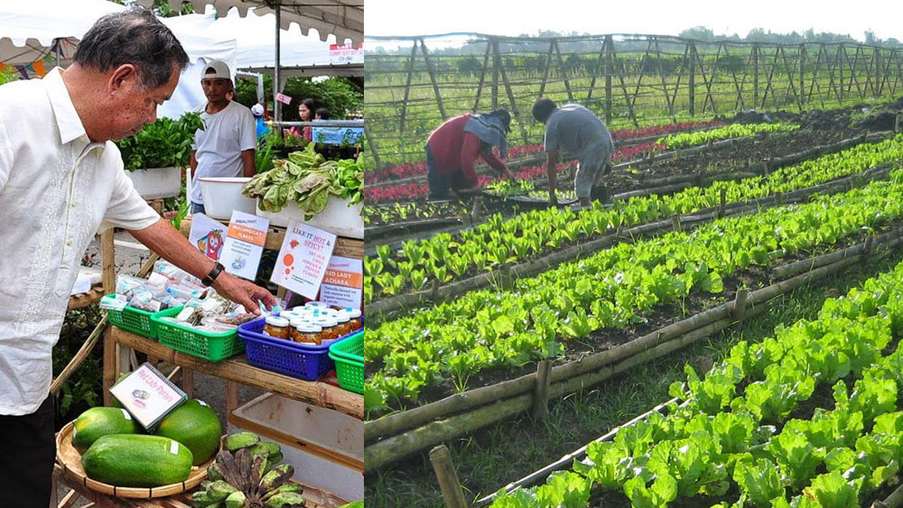
Paradigm shift: SUSTAINABLE AGRICULTURE and ORGANIC FARMING
From conventional to sustainable agriculture
Capability Building for micro and small cooperatives through enterprise development

Slide 12
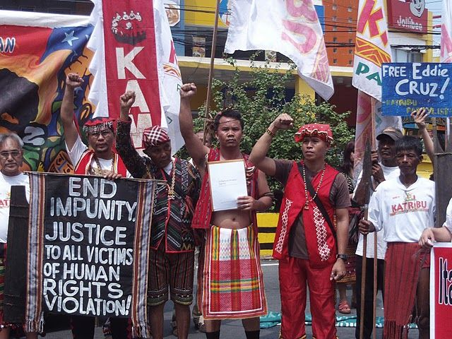
GROSS INEQUALITY – on Distribution of Power
IPs are rendered powerless when their lands are taken away for the sake of development either by local or foreign investors
Some are even imprisoned or worse, killed

Slide 13
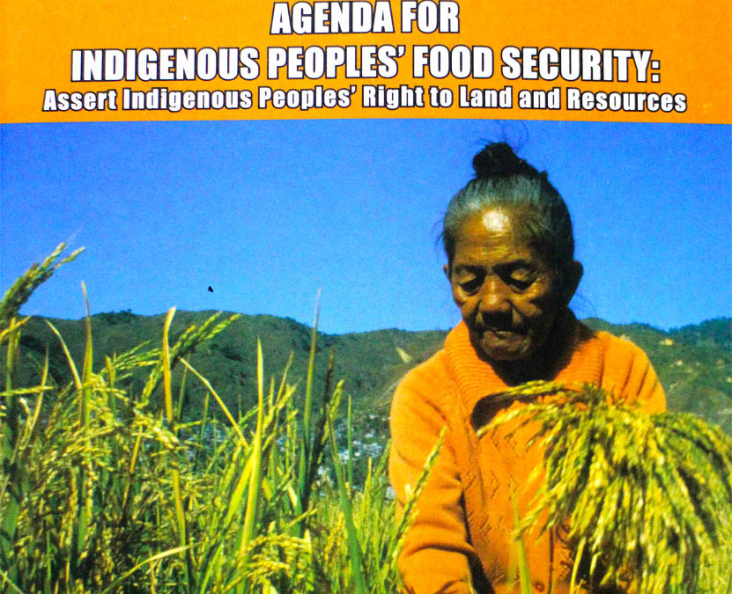
Paradigm shift: powerless to empowered IPs through cooperativism
Make land productive
Follow value chain

Slide 14
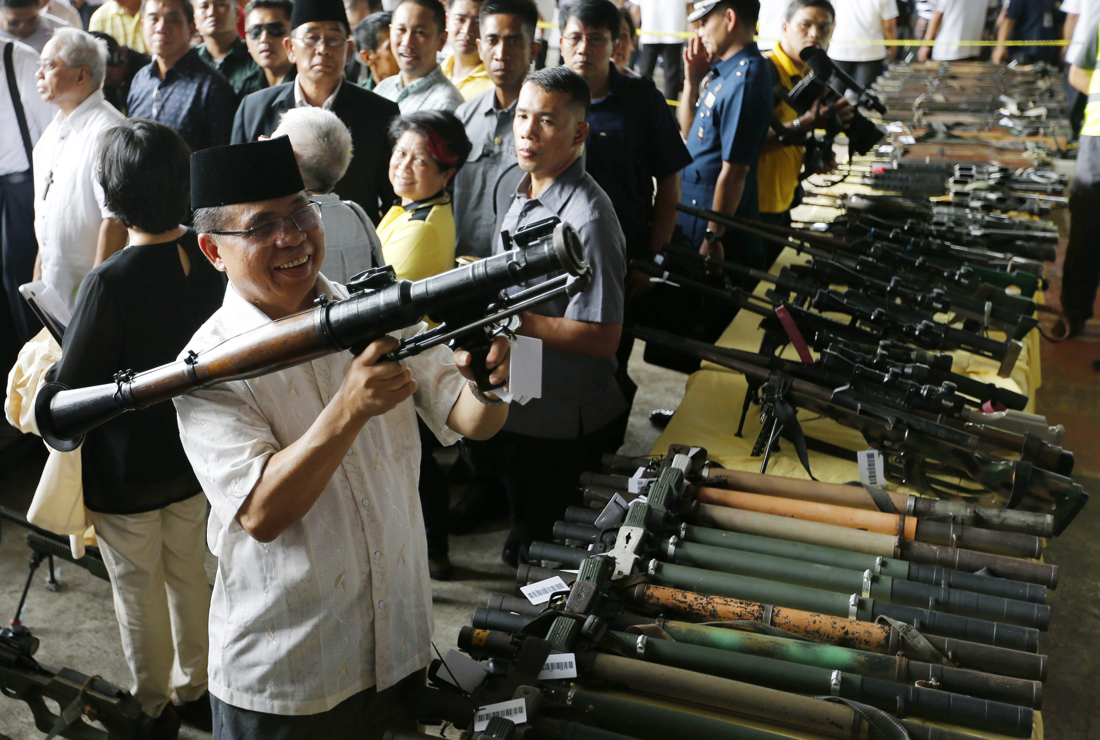
Paradigm shift: from arms to farms
MORO combatants surrender weapons, Government gives Them farm animals and farming tools as part of peace building programme

Slide 15
Paradigm shift:
7 Paths to Peace:
Peace through Sustainable Agriculture
Peace through protection, rehabilitation, conservation and preferential use rights of natural resources
Peace through rights-based management of utilities
Peace through good governance and people empowerment
Peace through human resource development
Peace through conflict transformation, management resolution, and
Peace through promotion of halal food
Erase “Negative Peace”
Advancing the essence of cooperativism through Peace in Mindanao

Slide 16
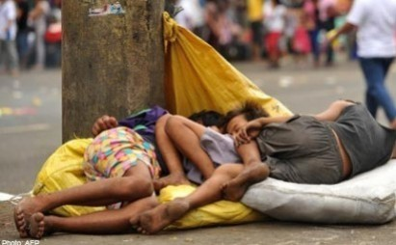
State of health
1 in every 2 children
LIVE IN POVERTY
25,000 children
DIE EVERYDAY
Nearly 1 child
DIES EVERY SECOND
28% malnourished
27% underweight
30% stunted
15% healthy

Slide 17
State of health
68% of personal health expenses are out-of-pocket
6 out of 10 die without seeing a doctor
80,000 infants die of curable diseases every year

Slide 18
State of health

Slide 20
All for Health Towards Health for All (The Duterte Health Agenda)

Slide 24
COOPERATIVE INITIATIVES ON PROVIDING HEALTH CARE SERVICES

Slide 25
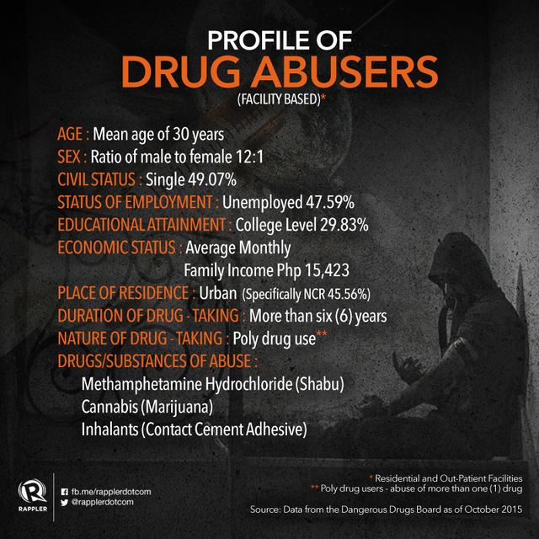
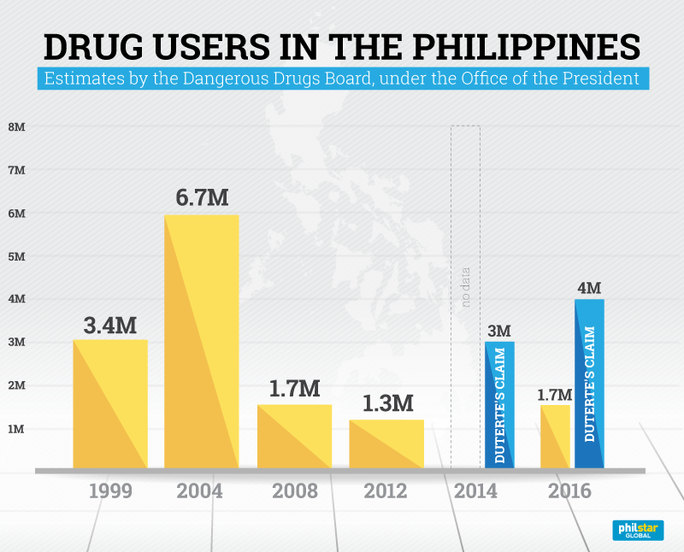
Drug situation in the Philippines:
Rampant drug abuse that contribute to the deteriorating health situation in the Philippines

Slide 26
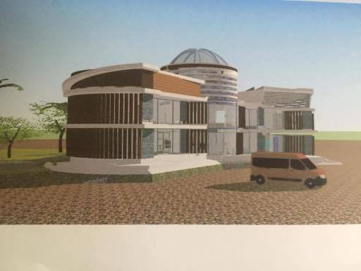
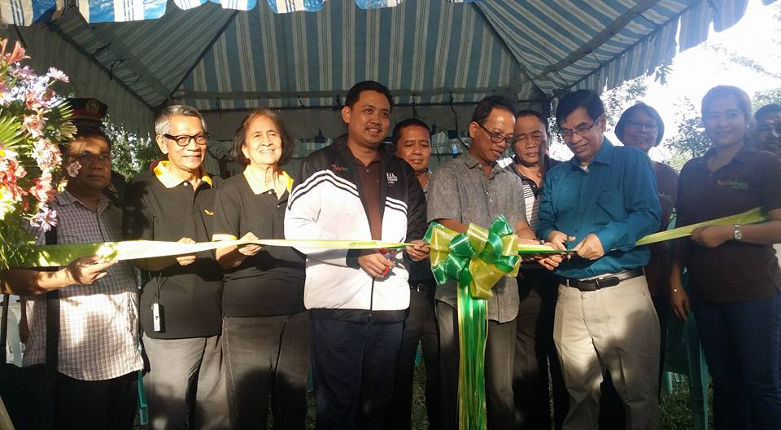
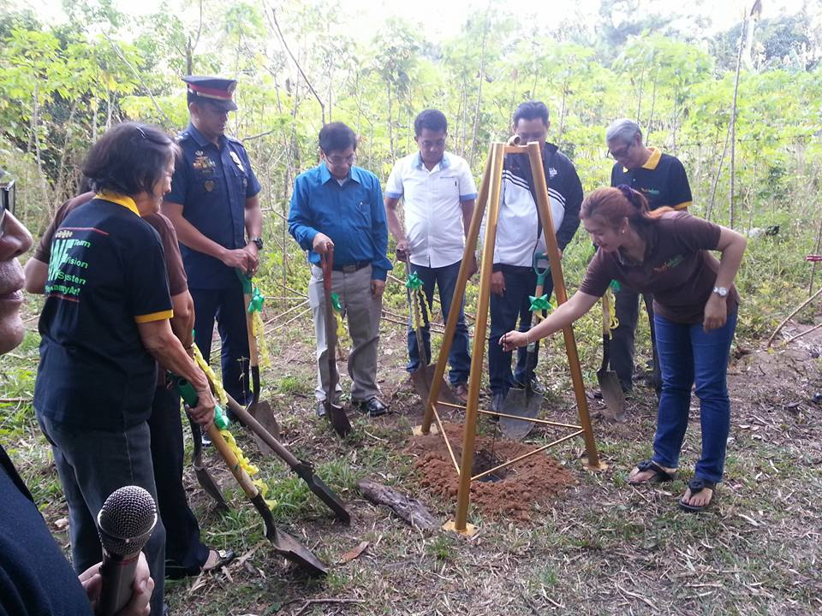
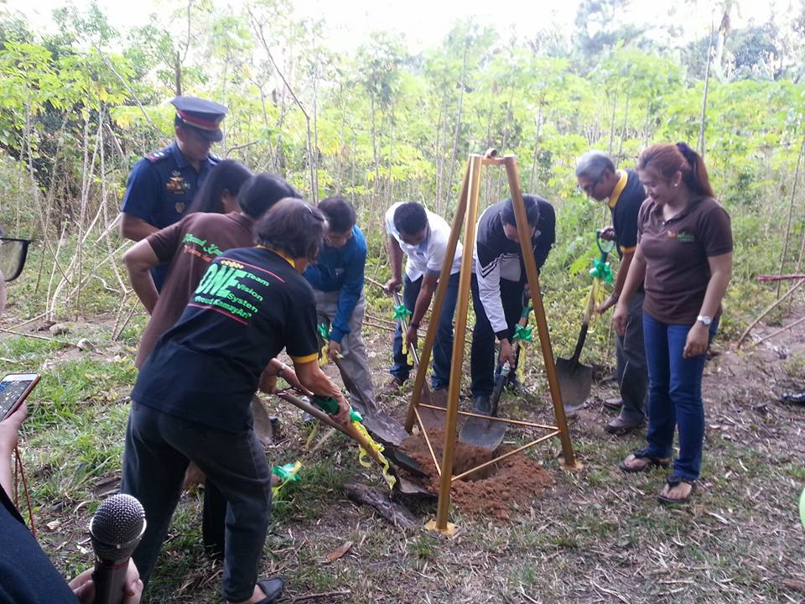
PARADIGM SHIFT:
Nutriwealth Holistic Rehabilitation Center and Ecological Park

Slide 27
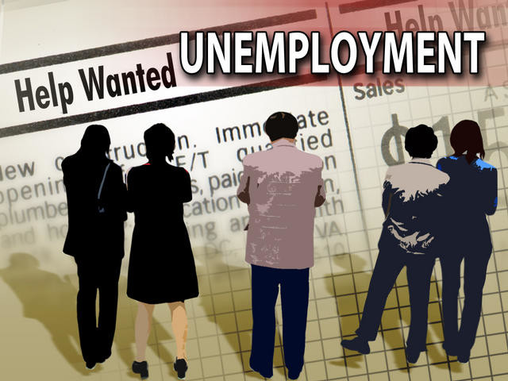
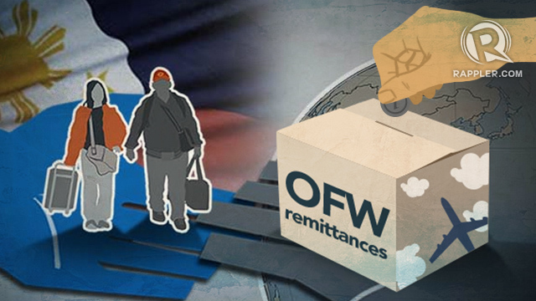
Job crisis
14 Million Filipinos are
un / under-employed
About 6,000 Filipinos leave daily to work abroad
Increasing jobs-skills mismatch crisis that confronts the new graduates every year

Slide 28
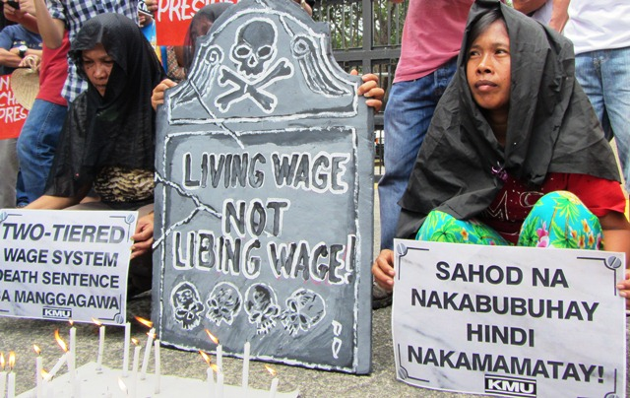
LOW WAGES

Slide 29
The paradox:
Labor creates wealth but the laborers remain in poverty

Slide 30
The truth:
power lies on labor, not on capital

Slide 31
Cooperative is the answer !
DNA of Cooperatives:
Members-owned
Value-based
Sustainable
“A Tool of Empowering the poor and the vulnerable to reduce poverty”

Slide 32
Cooperative is the answer !
Coalition of the poor to collectively have access and control over their resources
A vehicle of empowerment to democratize wealth and power and therefore lessen economic and social disparities

Slide 33
Empowering the filipino consumers:
Eliminate the 5-7 market layers
Go coop mart (bulk buying)
Go Gasoline Station
Go Coop pharmacy

Slide 35
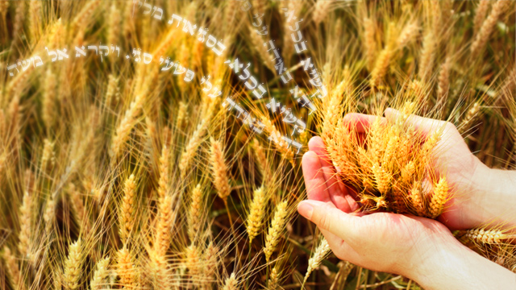
cooperatives going transformative for:
People
Planet
Prosperity
PEACE

Slide 36
Constitutional provision
The 1987 Constitution of the Philippines contain provision recognizing cooperatives as legal personalities with economic and social functions and mandating the creation of an agency to promote their viability and growth for the good of the nation.

Slide 37
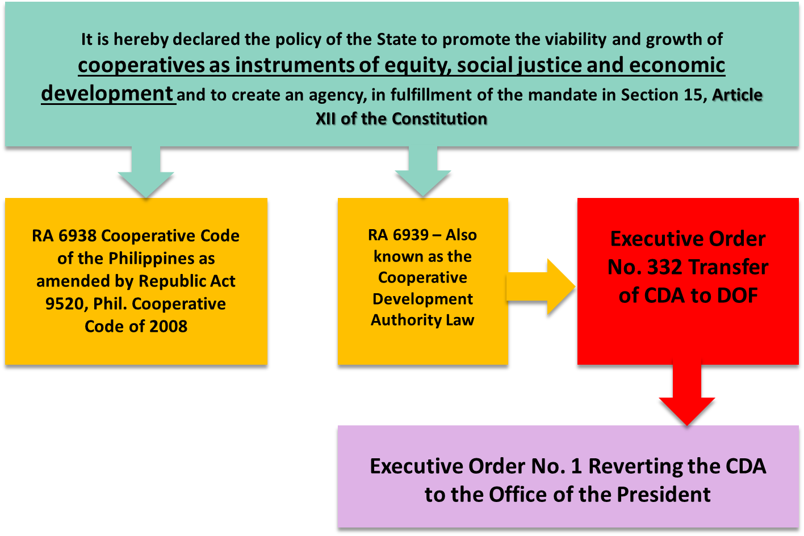
Legal basis for existence of cda

Slide 38
No. of cooperatives
About 26,600 cooperatives with members coming from all walks of life where
82.2% are micro
10.5% are small
belonging to the vulnerable sectors needing government development intervention such as technical, financial and institutional building supports to form viable business enterprise and build a competent governance.

Slide 39
Types of cooperatives
Credit
Consumer
Producers
Marketing
Multi-Purpose
Advocacy
Agrarian Reform
Cooperative Bank
Dairy
Education
Electric
Financial Service
Fishermen
Health Service
Housing
Insurance
Transport
Small scale mining
Water Service
Workers / Labor Service
Senior Citizen
Persons with Disability
Reformed MNLF and combatants
Indigenous peoples
Rehabilitated drug victims

Slide 40
Accelerate the drive to protect the ecological integrity of our environment. Cooperatives contribute to the protection of the environment for future generations.
Converting to sustainable agriculture and debunking conventional agriculture to ensure that the future generation’s needs are met.

Slide 42
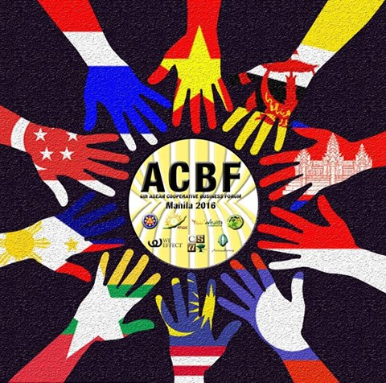

Slide 43
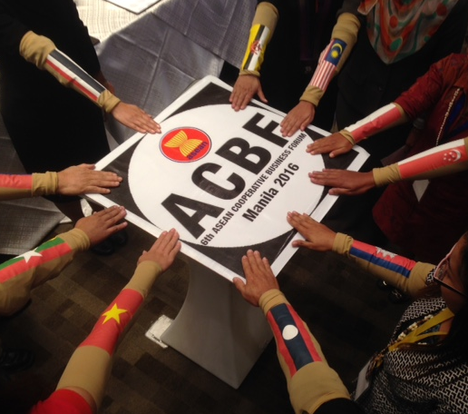
The 6th ACBF Declaration 30 November 2016
We, the representatives of the ASEAN Member States, and with the participation of other countries, cooperatives, farmers and fishers organizations, development organizations, and, civil society organizations, gathered during the 2016 ASEAN Cooperative Business Forum in Novotel Hotel, Quezon City, Philippines;
Recognizing that there is remarkable economic growth in the Asean region yet we still witness massive hunger and poverty as indicated by 560 million Asians who are struggling in the vicious cycle of poverty, especially in natural-resource-rich rural areas where majority of the Asean people live;
Alarmed by the growth-centered policies prioritizing profits and commodifying products have led to these increasing gross inequalities in the region as reflected by the global phenomenon where the wealth of only 88 families equal the combined assets of 3.5 billion or half of the world’s population;
Concerned that this gross inequality is intensified by the increasing degradation of the environment due to impact of climate change, and, over exploitation of natural resources such as heavy deforestation, degradation of land, groundwater depletion, massive use of toxic materials such as chemical inputs in agricultural production—which all made it difficult to sustain agricultural growth and tradeoffs in sustainability;
Understanding that the situation is alarming as the earth warms without let-up and the oceans are rising, while, at the same time, the Asean population is steadily increasing;

Slide 44
The 6th ACBF Declaration 30 November 2016
Recognizing the urgency and gravity of the situation, and the important role of cooperativism in addressing aforementioned challenges, we now come together in advancing the welfare of at least 300 thousand agriculture cooperatives and farmers organizations in Southeast Asia to rise to the aforementioned policy gaps, failing developmental models, and environmental-related issues;
Recognizing that the objective of ACEDAC is to increase the access of agri coops in Asean market and promote the exchange of info and technical expertise of the cooperatives in ASEAN countries.
With a firm conviction, we commit to:
Champion the eradication of extreme poverty and hunger especially among small farmers, indigenous communities and fisher folks who ironically produce the food needs of the ASEAN people and of the world;
Promote and advance social solidarity economy through cooperativism where people and the environment are the priorities more than profit towards attaining inclusive development;
Strongly advocate sustainable agricultural technologies and promote local industries towards sustainable livelihoods and conservation of natural resources;

Slide 45
The 6th ACBF Declaration 30 November 2016
In moving forward, we will unite in building an informed constituency in the ASEAN region to:
Be the voice and institution of the poor and the excluded in resisting growth-centered development aggressions, and, instead, promote people-centered development with emphasis on benefiting the small holders;
Consolidate our efforts and promote the inter-country collaboration, such as learning exchanges, coop-to-coop trade, capacity building, information sharing, etc. in fostering sustainable development of agri-cooperatives; and,
Advocate for legal framework and/or enabling policies and appropriate programs
Funding support for development of agri-cooperatives among the Member States;
Promote continuing social dialogue and ensure institutionalized and meaningful participation of farmers’ organization (FOs) and civil society organization (CSOs) in various ASEAN processes concerning agri-cooperatives such as AMAF, ACEDAC, and, ASWGAC, among others;
Facilitate and promote linkage with other platforms (e.g. NEDAC, ICA, etc.) and private sector;
Promote youth, gender equality and women empowerment to have increased participation in the agri-cooperative sector.
Signed on the 30th day of November 2016 in Quezon City, PHILIPPINES.

Slide 46
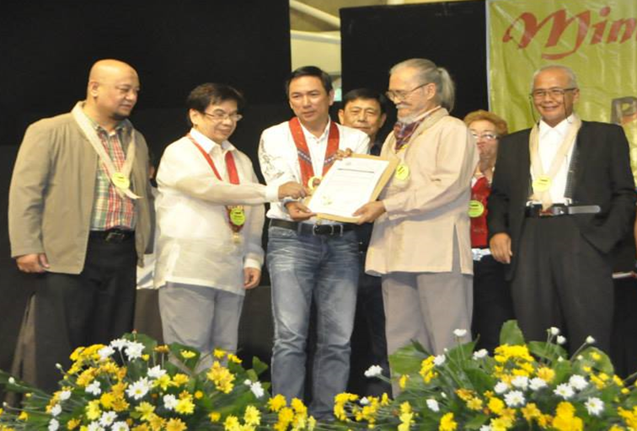
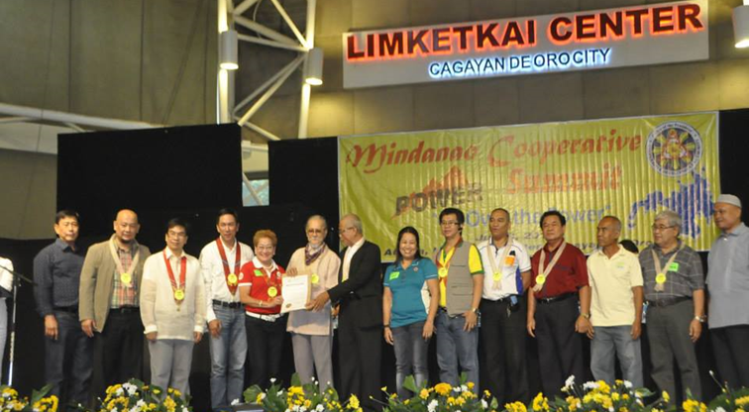
1 Mindanao Energy Cooperative Federation (1MIECOOP)
An advocacy cooperative, it has an initial number of 28 cooperatives from all over Mindanao.
An advocacy cooperative, it has an initial number of 28 cooperatives from all over Mindanao.

Slide 47
Will operate with four aims:
People Empowerment, Inclusive Growth and Development, Equalizer of power and help local products in embracing the AEC. COOP TV will become a university on TV which will purvey free and truthful developmental information and an advocate for environmental and cultural protection for Filipinos and the real watchdog for democracy.

Slide 48
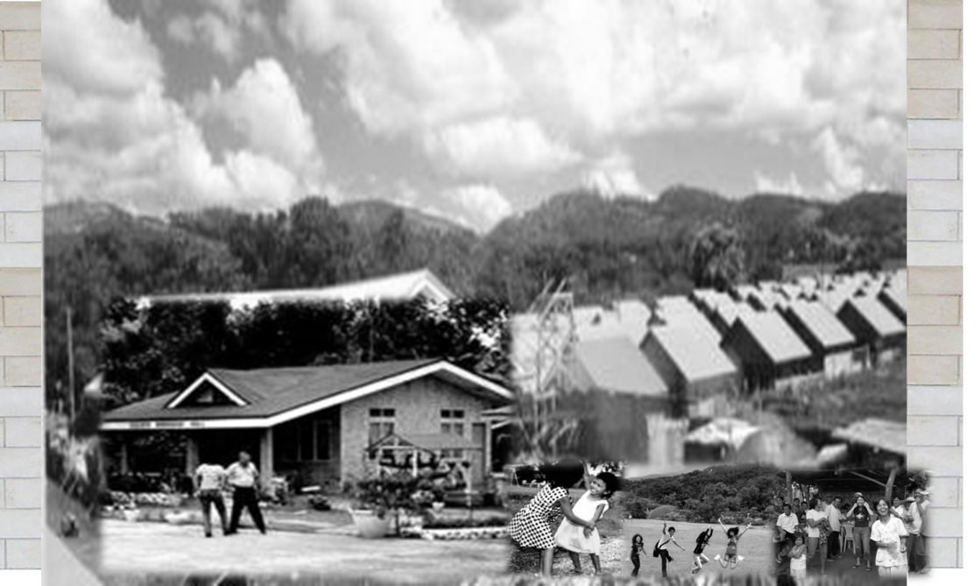
CO-OP VILLE: A sustainable co-operative housing community
The Co-op Ville is envisioned as a sustainable cooperative housing project that aims to build not only physical houses but develop a sustainable community as well.

Slide 49
COOPERATIVISM: the BACKBONE OF FEDERALISM!

Slide 50
Thank you !

