Slide 1
AGRICULTURAL COOPERATIVES ACTIVITIES IN MYANMAR
24-6-2014

Slide 2
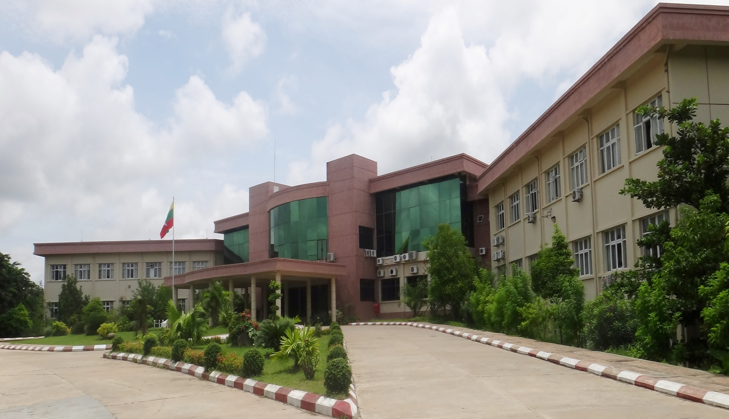
Ministry of Cooperatives
Myanamar

Slide 3
Agricultural Information
Total Land Area – 676577 km²
Cultivated Area – 12.02 million ha
Average farm Management Area – 4.05 million ha
Rural Population – 41.437 million
Total Population – 59.78 million
Myanamar

Slide 4
At the new government age of the Republic of the Union of Myanmar, it has laid down (8) development tasks to alleviate the poverty. Cooperative development task is one of them. Therefore, the Ministry of Co-operatives has laid down two objectives and five main tasks Two Objectives to implement the cooperative developing tasks.
Myanamar

Slide 5
The Eight Tasks for the Rural Development and Poverty Alleviation
Development of Agricultural productivity
Development of Livestock breeding and fisheries and socioeconomic life
Development of rural small-scale productivity
Development of micro saving and credit associations
Development of cooperative tasks
Development of rural energy
Environmental conservation
Collection and analysis of rural development
Myanamar

Slide 6
Structure of Ministry of Cooperatives
Ministry of Cooperatives
Cooperative Department
Small Scale Industry Department
Cooperative Trade
Promotion
Department
Central Cooperative Society (1)
Region/State Union of Cooperative Syndicates (20)
Region and State Cooperative Department
(14)
Township Cooperative Syndicate (459)
Township Cooperative Department
(306)
Primary Cooperative Society ( 22342 )
Notes:
6

Slide 7
Two Objectives
To improve the socio-economic life of rural and urban people at grass-roots level.
To support with fully strength by cooperative business for the development of the nation’s economy.
Myanamar

Slide 8
The Main Business Conducting by Ministry of Cooperatives
The Ministry of Cooperatives is mainly conducting the following business to support the peoples’ agriculture and livestock breeding-
Microfinance
To upgrade the cooperative societies
Myanamar

Slide 9
The Current Situation of Cooperative Societies as of (31-5-2014)
No. |  | Type of Society | Total Societies (31-5-2014) | Remark
1 |  | Central Cooperative Society | 1
2 |  | Production | 20745
 | 1 | Agricultural Cooperative Society | 18170
 | 2 | Livestock Cooperative Society | 2100
 | 3 | Forestry Cooperative Society | 15
 | 4 | Industrial Cooperative Society | 460
3 |  | Services | 4016
 | 1 | Transportation Cooperative Society | 107
 | 2 | Microfinance Cooperative Society | 3694
 | 3 | Social Cooperative Society | 35
 | 4 | Construction Cooperative Society | 50
 | 5 | Other Services Cooperative Society | 130
4 |  | Trade | 2792
 | 1 | GEC Cooperative Society | 443
 | 2 | Store Cooperative | 42
 | 3 | Trading Cooperative Society | 1672
 | 4 | General Economic Business Cooperative Society | 635
5 |  | Region/State Union Cooperative Syndicate | 20
6 |  | Township Cooperative Syndicate | 280
 |  | Total | 27854

Slide 10
Agricultural Sector and its Products
Rural dwellers where farming is main stay of occupation.
Total current labour force is estimated to be 18 million, of which 63% are engaged in agriculture sector.
41% of the total GDP and 11% of foreign exchange earnings.
Rice, Pulses, Beans and Peas, Oilseeds, Fruits and Vegetables, Sugarcane, Soft Wood, Hard Wood, Fish and Fish Products are produced in Myanmar
Myanamar

Slide 11
Plan of Microfinance
Ministry of Cooperatives aims on Microfinance business to cover all over the country by 2015 for effective performance of socio-economic development and poverty alleviation. And MOC is planning to examine and increase the amount of loan up to (5) lakh Kyat per household.
Myanamar

Slide 12
Current Condition of Supporting the new Cooperative Societies and Members
The ministry has been operating such business for the members who live in rural and urban areas to smooth and secure for their lives and to stand on their own within the next four or five years and to be self -reliance, self-sufficiency and then to be sustainable development of cooperative societies.
Myanamar

Slide 13
The Current Situation of Microfinance, Hire Purchase and Upgrading of Cooperative Societies
Microfinance Loans - 194058.226 kyat Million
Region/ State / Nay Pyi Taw council - 15
Township - 306
Cooperative Societies - 23635
Beneficiary cooperative members’ families - 1899601
The machinery sold by hire purchase system - 6680
Buyers (Cooperative members) - 6607
Supporting Loans for upgrading of cooperative - 16335.8
society(Mechanized farming, livestock breeding,
Electricity)
The repayment rate - 97%
Myanamar

Slide 14
Conclusion
The ministry has been endeavoring to succeed two objects and five main tasks and to form the solid cooperative societies in every village, quarters, townships, states, and regions by cooperating and coordinating among the responsible staffs from different levels of cooperative departments and board of directors from different levels of cooperative societies.
Myanamar

Slide 15
Thank You
Myanamar

